Slide 1
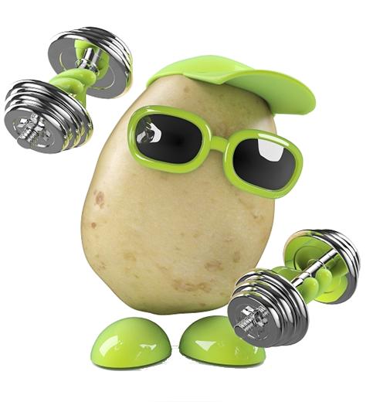
Coach Potato
Health Tracking and Analysis Application

Slide 2
System Context and unique selling points
Free desktop fitness tracking and analysis application
Walking, running, cycling
Tracks fitness progress of users with an emphasis on motivation
Goal based and feedback driven
Targeted towards young to middle aged casual exercisers
Simple and user-friendly focus
“Dumbs” down complex health/fitness lingo
Notes:
Coach Potato is a fitness tracking device that prioritizes the analysis of walking, running and cycling. The application allows users to set goals and constantly receive feedback on their progress towards meeting these. Our app is targeted towards young to middle aged casual exercisers who wish for a simple and user-friendly way of measuring progress towards their fitness goals. However experienced athletes may also choose to use the application. Coach Potato is a feedback driven application that. The main unique selling point of Coach Potato over existing products is its simplicity and focus on satisfying the needs of the fitness-casual users. Our application "dumbs down" complex fitness lingo and technical terms that are often designed for fitness enthusiasts. For this reason, we believe that Coach Potato can become a preferred application for the non-elite, casual athlete type.

Slide 3
Summary of key features and services
· Create profile
· Choose fitness goals to work towards
· Progress tracking of goals
· Manually input or import data
· Health analysis and warnings
· Integration of web search feature
· Maps of routes based on activities
· Calendar views of activities
· Activity Statistics
· Graphical representations
· Motivational messages
Notes:
Coach Potato is an application that allows users to create profiles and have goals that they wish to track their work towards. The user can import activity data from an external fitness tracking device, which the app then analyzes. This analysis determines how the user is progressing towards reaching their goals. Goals to choose from include weight-loss, distance, speed, activity frequency and more. The analysis offered to the user includes BMI, graphical representations of distance over time, heart rate over time, calories burned, stress level over time and maps of routes based on activities. Furthermore, the app offers health warnings based from the data analysis and integrates a web search feature to search for health-related information. A calendar is also available for the user to plan and review their fitness activities. Daily motivational messages shall be available to the user at any time from the user’s profile page.

Slide 4
Why worth developing?
To make fitness more enjoyable
To make a positive impact on obesity in New Zealand
Inspire kiwis to be more active
Decrease the current adult obesity rate
Notes:
As a team, our goal is for our application to make a positive impact on obesity in New Zealand. We are determined to inspire more kiwis not to only be more active but enjoy doing so. A 2017 survey conducted by the NZ Ministry of Health found that 34% of adults (15 years or older) are overweight and 1.2 million kiwis (a further 32%) were deemed to be obese ^{[1][2]}. Overweight was defined as having a BMI between 25.0 and 29.9 and obese as having a BMI of 30.0 or greater.
We are strong believers that the increasing rate of in obesity across NZ is becoming more and more concerning every day, and we hope that Coach Potato can contribute towards changing this.

Slide 5
Stakeholders
Number | Stakeholders | Priority
1 | Casual Exercisers (Users) | High
2 | SENG202 staff | Average
3 | Experienced Athletes (Users) | Low
4 | Developers | Low
Notes:
Prioritizing our Stakeholders rightly is one of the key task for our project as it has a huge impact on our overall project success. We have prioritized the casual exercisers than any other stakeholder as they are the main target market for Coach Potato. The course staff have an average priority as they are our clients and have set the requirements for this product. Experienced Athletes and Developers have Low priority as athletes are not our main target but still we do not want to stop them from using our app. Then are the developers who are the ones producing the software but their design choices are determined by other stakeholders.

Slide 6
Possible Concerns
Unfriendly User Application.
Change or Miscommunication of Requirements.
Conflicts between Developers.
Notes:
Application might not be user friendly and the user might not have a clear understanding of how to use the app. Clients might change the requirements anytime during the project or there is miscommunication or misunderstanding regarding the initial requirements (Very likely). Developers could have conflicts due to different ideas, choices, style of work, cultures, etc.

Slide 7
Quality Requirements and Key Drivers
Stakeholder | Weight | Usability | Security | Performance | Reliability | Legal | Development
Users | 0.7 | 40 | 10 | 15 | 30 | 5 | 0
SENG202 staff | 0.3 | 20 | 5 | 20 | 25 | 5 | 25
Total | 1.0 | 34 | 8.5 | 16.5 | 28.5 | 5 | 7.5

Slide 8
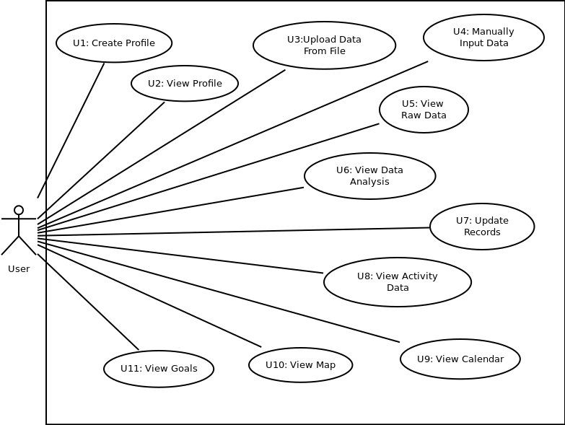
Use Cases
Main use cases:
Upload Data From File
View Raw Data
View Data Analysis
View Activity Data
Use cases we decided to add:
Create Profile
View Profile
View Goals
Notes:
The main use cases are upload from file, view raw data, view data analysis and view activity data. These use cases make up the core of the application. One actor was decided upon because every function of the application was planned to be accessible by every type of user. The use cases are dependent on one another in some cases, and this is further explained in the textual descriptions. For example, most use cases are dependent on the user having a profile. There are extra use cases we designed, including the profile use cases and the view goals use case.

Slide 9
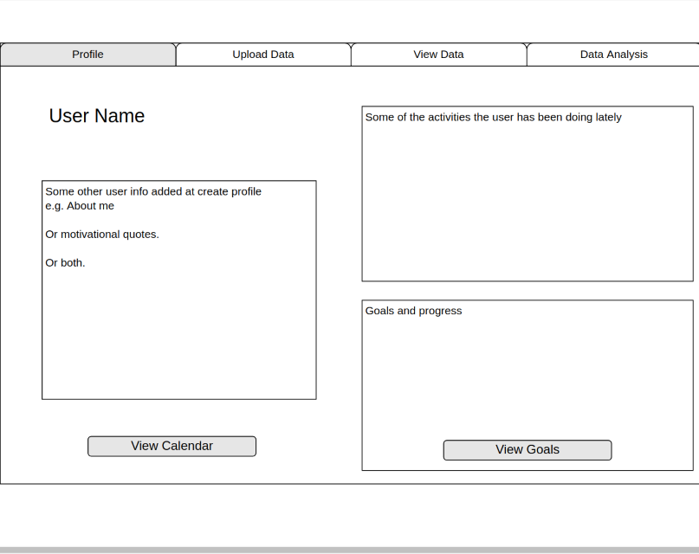
GUI
Calendar
Goals
Some activities
Quotes
User info
Notes:
The profile is where the calendar and goals can be accessed from. These will open up in seperate windows when the buttons are clicked.

Slide 10
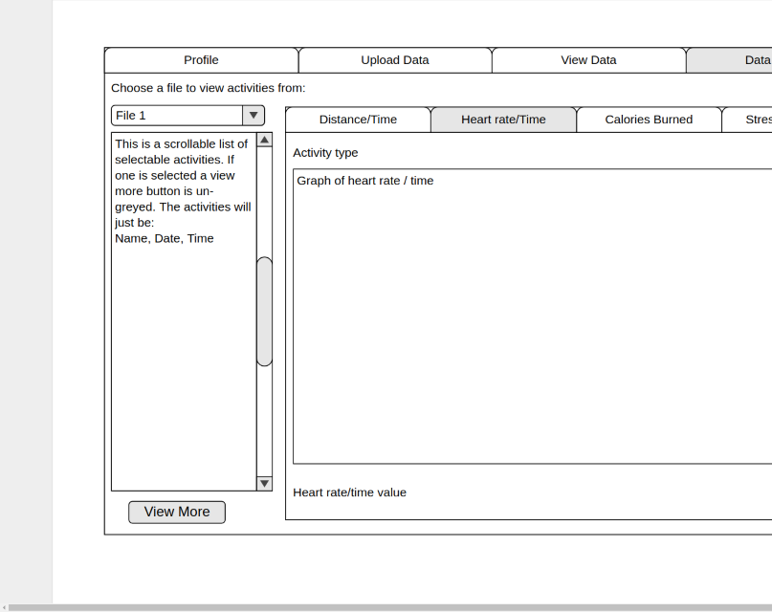
GUI
Sub-tabs
View more
Graphs
Notes:
In data analysis, activities can be selected from the side bar. A graph will be shown and analysis will be shown for the selected activity. View more leads to a screen which shows a map and more detailed analysis of the activity.

Slide 11
UML Class Diagram
Presented by Andrew Holden

Slide 12
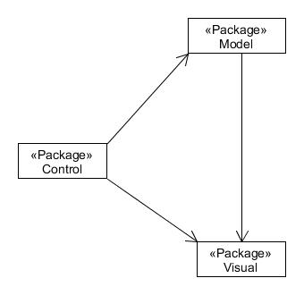
Model Visual Control

Slide 13
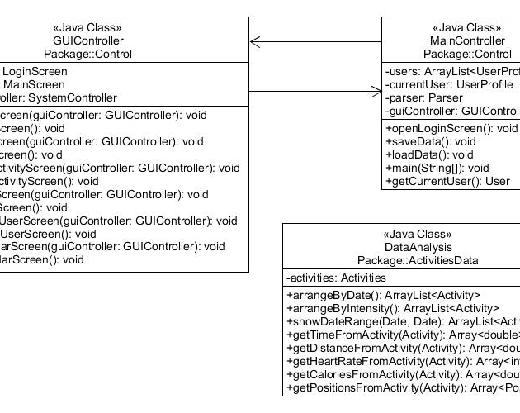
Control

Slide 14
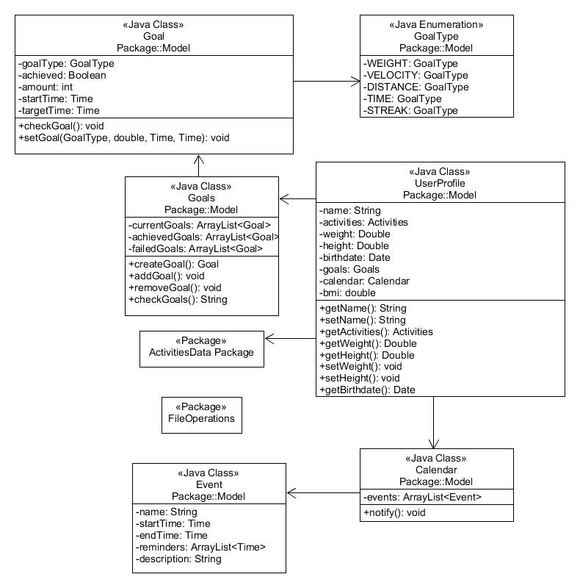
Model

Slide 15
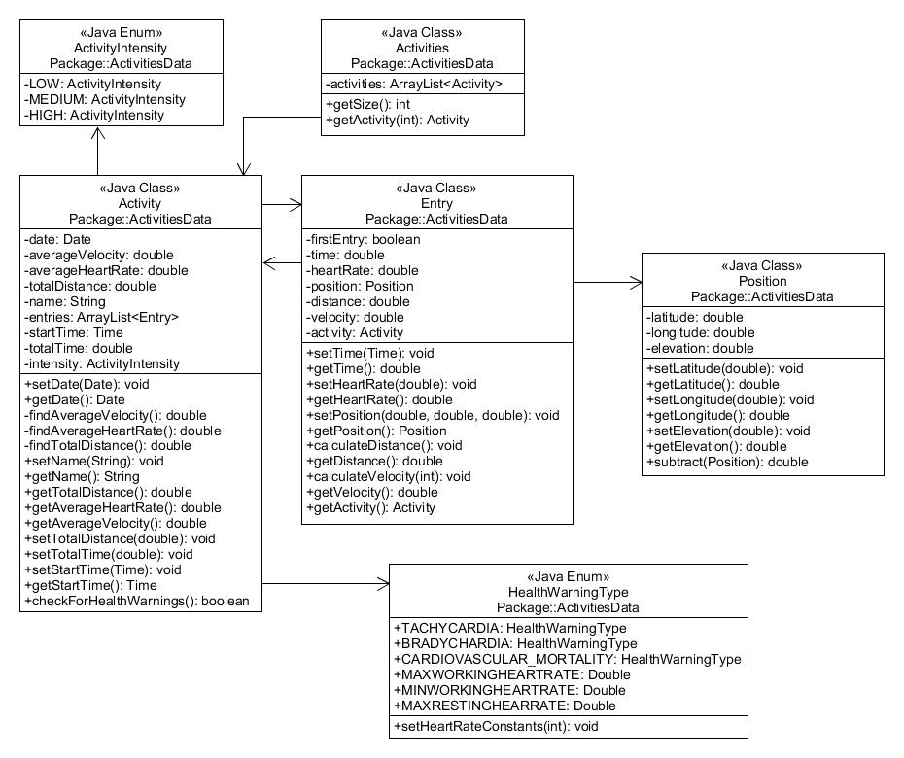
Activities Data

Slide 16
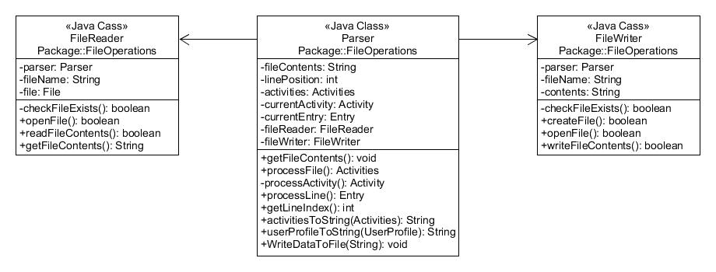
File operations

Slide 17
Risk Assessment
ID | Description | Probability | Impact | Responsibility | Consequences | Prevention
1 | Team Unavailable | 3 | 2 | Absent team member | Delay of work | Effective communication,
11 | Not finishing tasks on time | 2 | 2 | Team Members | Getting behind on schedule | schedule planning, work division
12 | Not meeting dates for Deliverables | 1 | 3 | Team Members | Grade Penalties | buffer times before due dates.
9 | Bugs in the code | 3 | 2 | Team Members | crashes, unexpected behavior | High test coverage and frequent testing

Slide 18
Project Plan
Today:
Begin coding the file storage system and file uploading.
Next Week:
Discuss the second deliverable further and re-assign tasks for the week. Continue working on the file storage system and file uploading. Begin implementing a raw data viewer and some analysis.
Holidays:
Re-assign tasks. Continue to work on raw data viewer and analysis. Begin working on profiles and graphical representations of data. Code freeze on the first weekend of the holidays. Second week of the holidays is free time.
Notes:
Gantt was used to create a chart outlining all the tasks to be done. Personal commitments and holidays were taken into account when planning this, and the second week of the holidays is free time as some members are away or have medical appointments. To achieve the goal, the team will meet every week and continually re-assess and re-assign tasks to make sure the team is on track.

